Slide 1


INFO 5100
Application Engineering & Development
Team
Filter Coffee
Team Members Abhinav Nagaraj
Dileep Ravindranath Holla Mahesh Vatalu Renukaprasad

Slide 2
250,000
60-80%
Veterans Leave the Military Every year
Left the military without access to adequate higher education, vocational training, access to adequate mental healthcare or employment

Slide 3

What does it mean to leave the Armed Forces?
Relocating, living independently for the first time
No access to adequate mental healthcare
No access to adequate Higher Education
These major life changes are challenging for military veterans, just as they are challenging for anyone.
The challenges associated with these changes are not easily studied or represented, in part because they are not captured by medical diagnoses, and in part because it is difficult to draw meaningful lines between physiological, psychological, and social problems.
Moreover, this stuff of everyday life tends to be overshadowed by veterans’ other, more extreme, experiences in combat.

Slide 4


Slide 5
So, what can we do to help this situation?
Develop, design and deploy a multi-party organization that can connect the veteran to one or more organizations
Incorporate Medical, Education, Employment & Housing Enterprises.
Multiple organizations under the said enterprises under which the veteran can apply for training, seek medical help etc
Organizational users can review applications/requests and approve/reject the same - or if required route them to other organizations under a different enterprise
Healthcare
Organizations
Veteran
Educational
Institutions
Housing Organizations

Slide 6
Ecosystem Architecture
Physical Health
Rehab Enterprise
Mental Health
Medical Enterprise
Vocational Training
EcoSystem
Education Enterprise
Graduate School
Housing Enterprise
Temporary Shelters
Job Enterprise
Permanent Housing

Slide 7
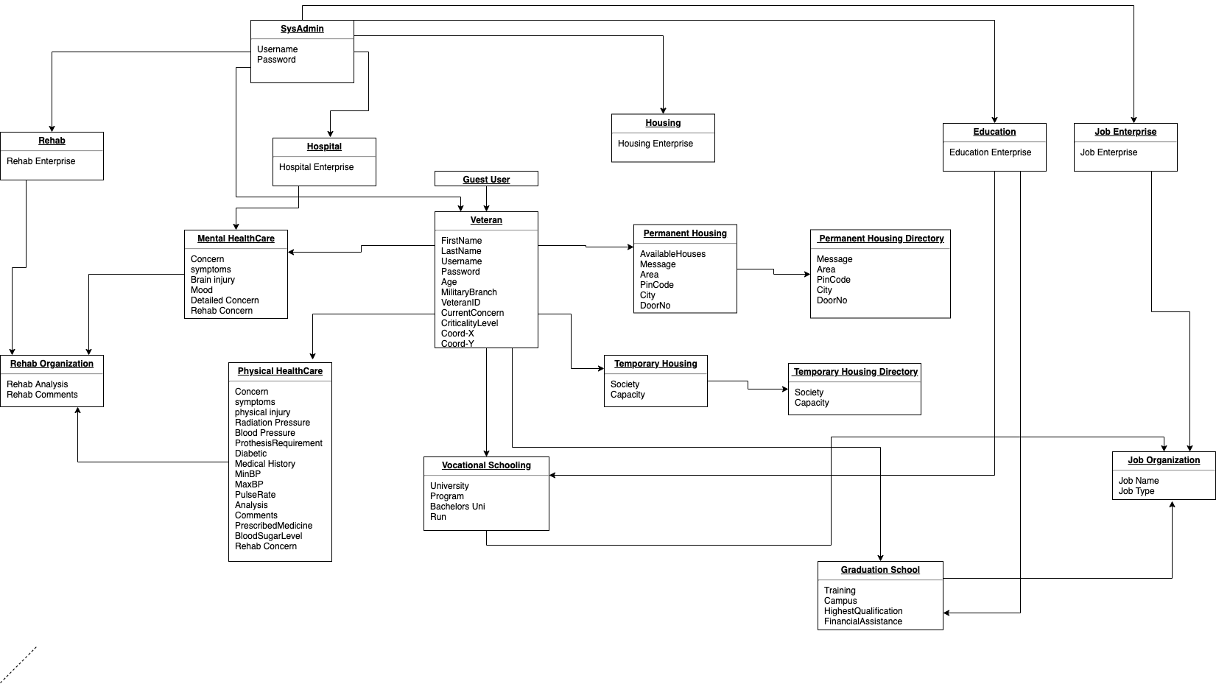
Object Model

Slide 8
Features
1
3
Ease of Access User can raise multiple requests, under multiple categories - Medical, Education or Housing. The user can perform all this straight from the User Dashboard
Real Time Notifications User is notified of all requests raised, updates to requests raised - in real time via Notifications delivered through Telegram & Email. Telegram’s API and SMTP Protocol has been leveraged to push notifications in real time.
Real Time Reporting PowerBI has been leveraged to enable real time reporting. The Sysadmin can view the total number of requests raised, requests pending resolutions etc from a Web Browser or Smartphone
2
4
User Tracking All Admins can view and track the veteran location using a single click. This has been done by using Google Map’s API

Slide 9
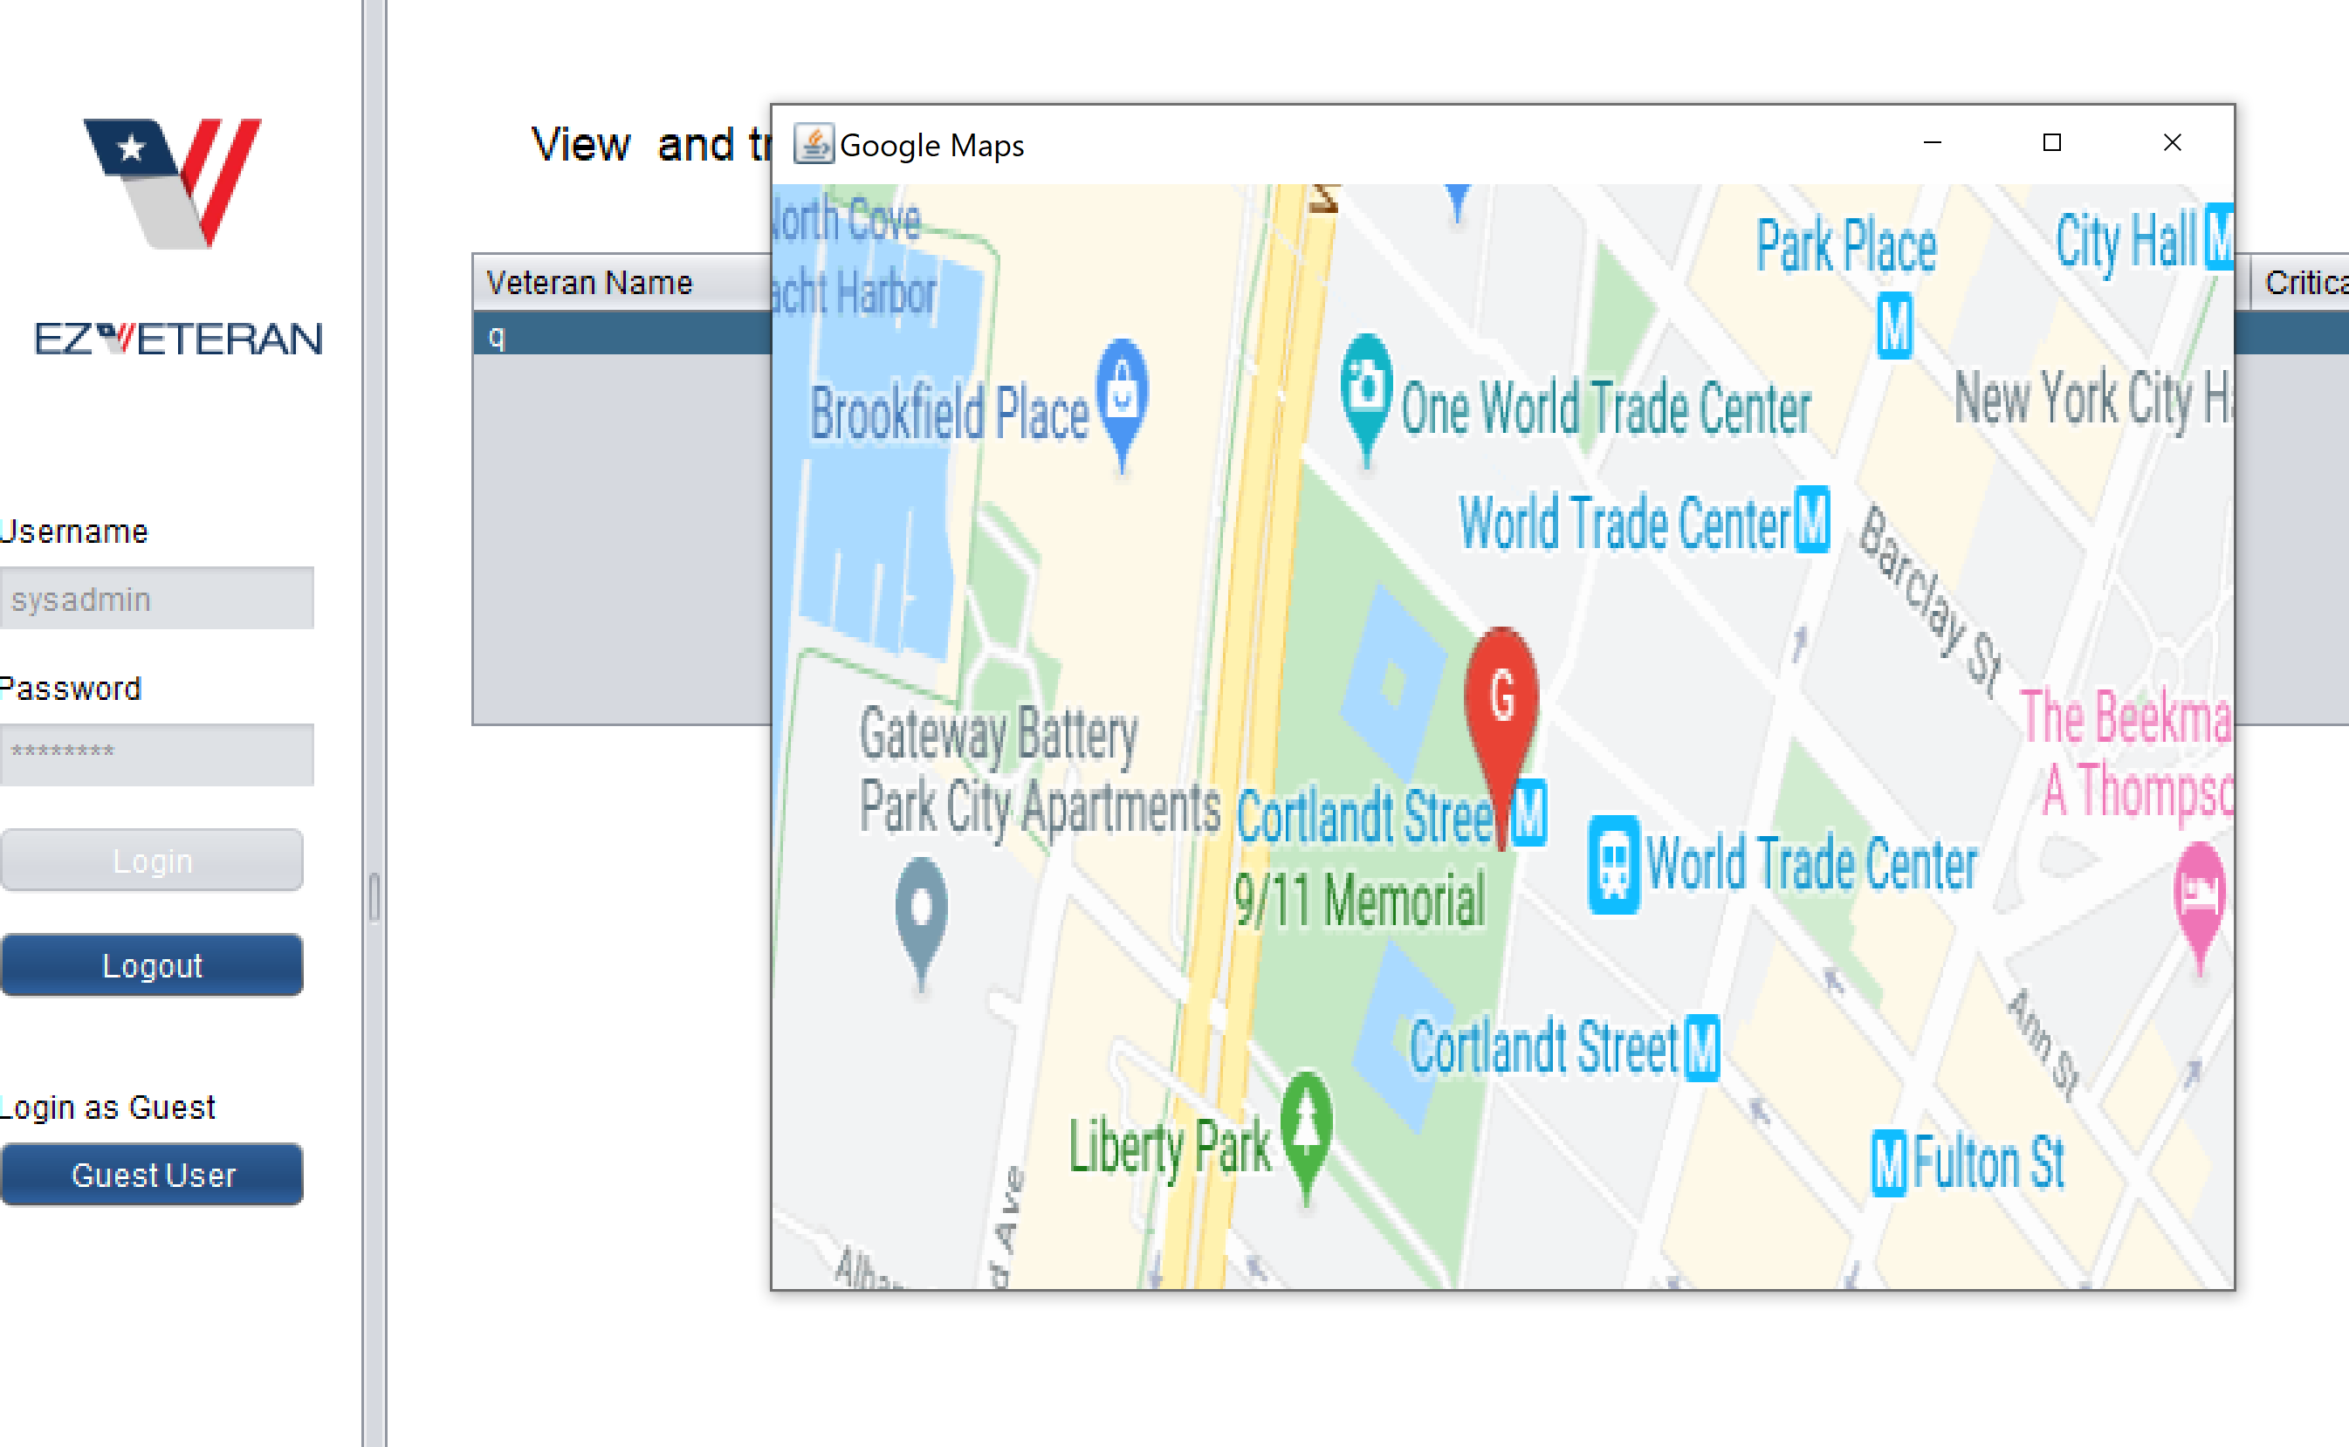
Google Maps for Veteran Tracking

Slide 10
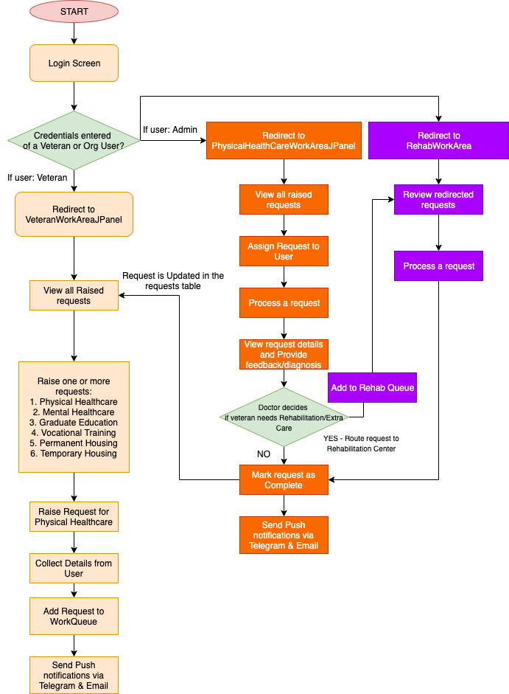
User Request Workflow
Veteran initiating a medical request/concern and effective resolution by the doctor.
The same workflow is applicable to all requests raised between the user & organizations - for example, requesting for Temporary Accomodation or Applying for Higher Education / Vocational Training

Slide 11
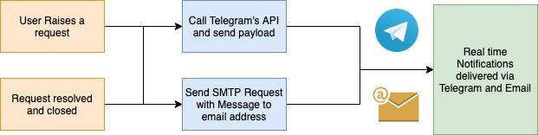
Real Time Notifications

Slide 12
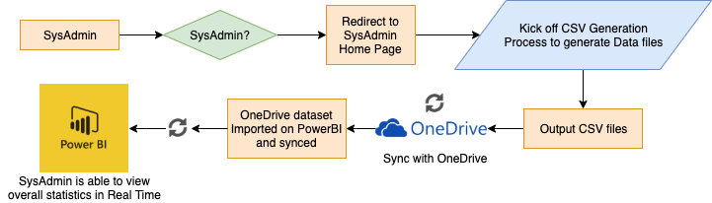
Real time Reporting

Slide 13
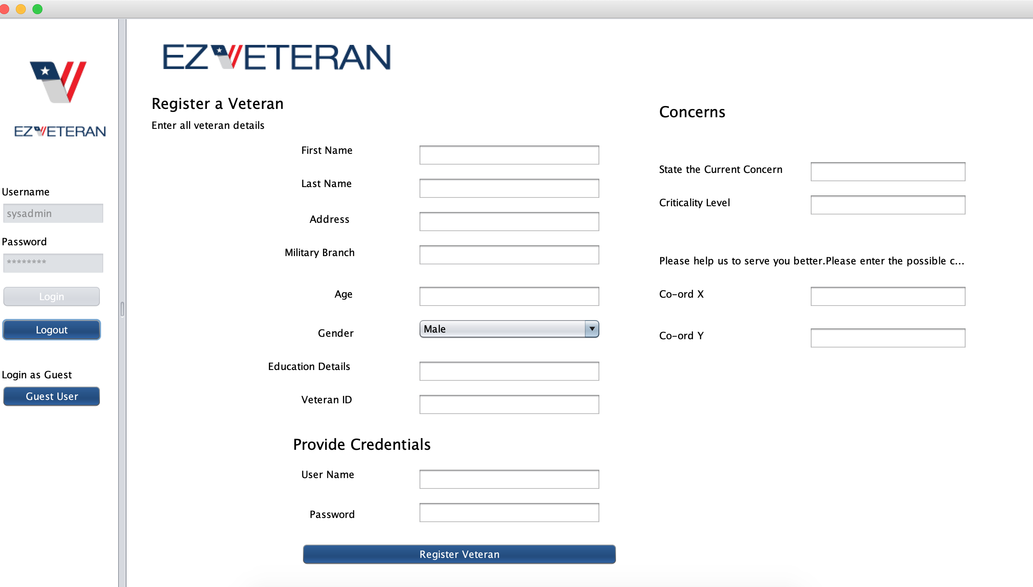
Screenshots

Slide 14
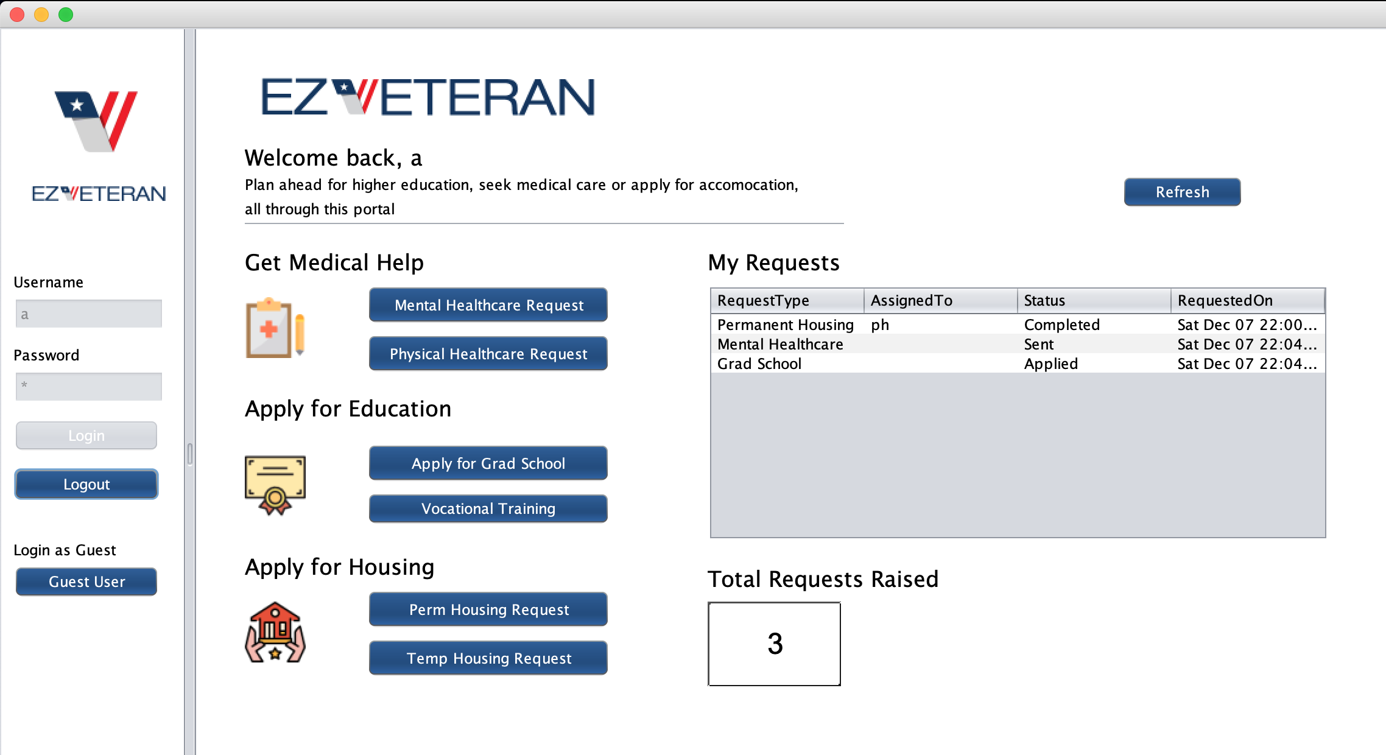
Screenshots

Slide 15
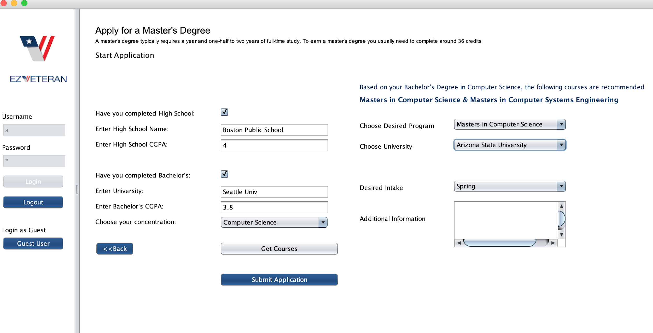
Screenshots

Slide 16
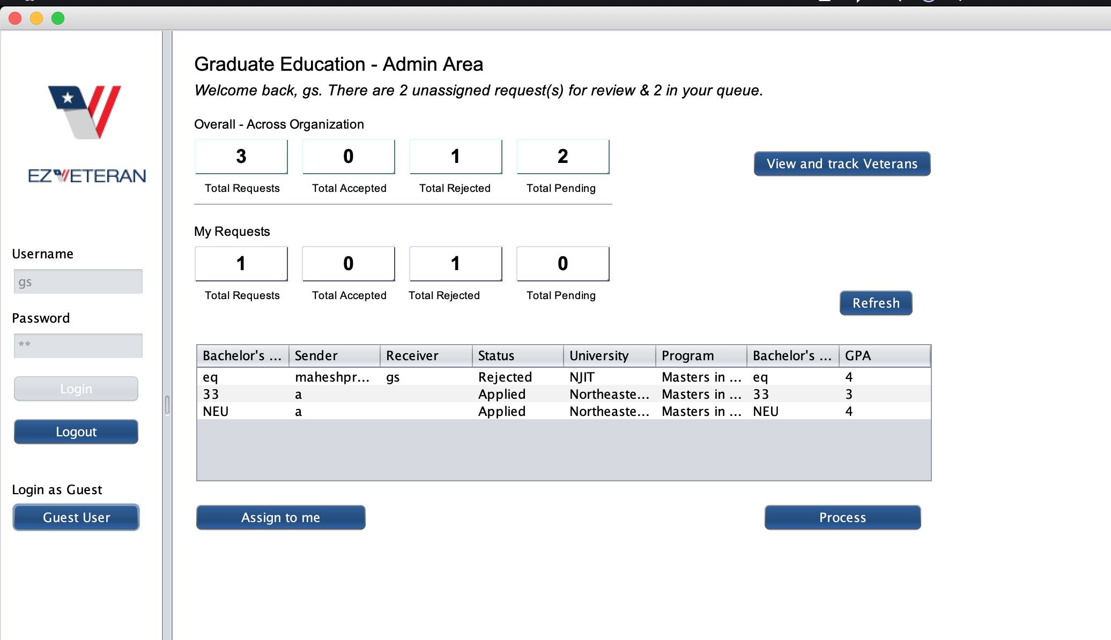
Screenshots

Slide 17
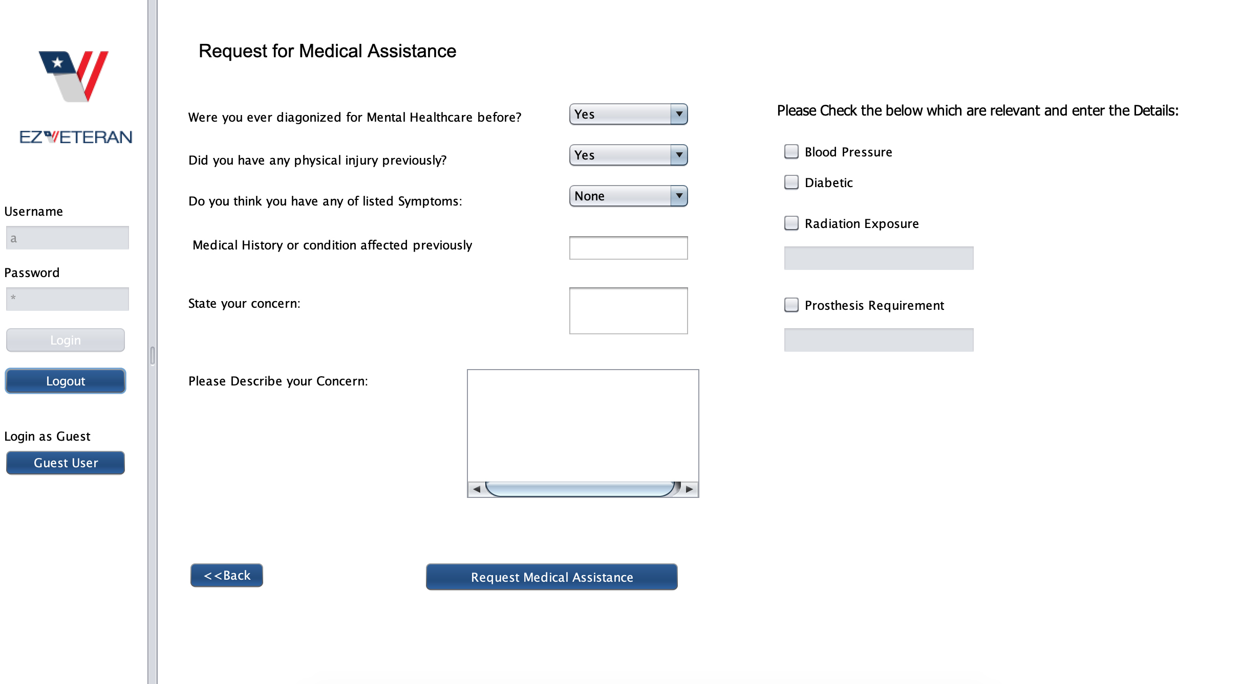
Screenshots

Slide 18
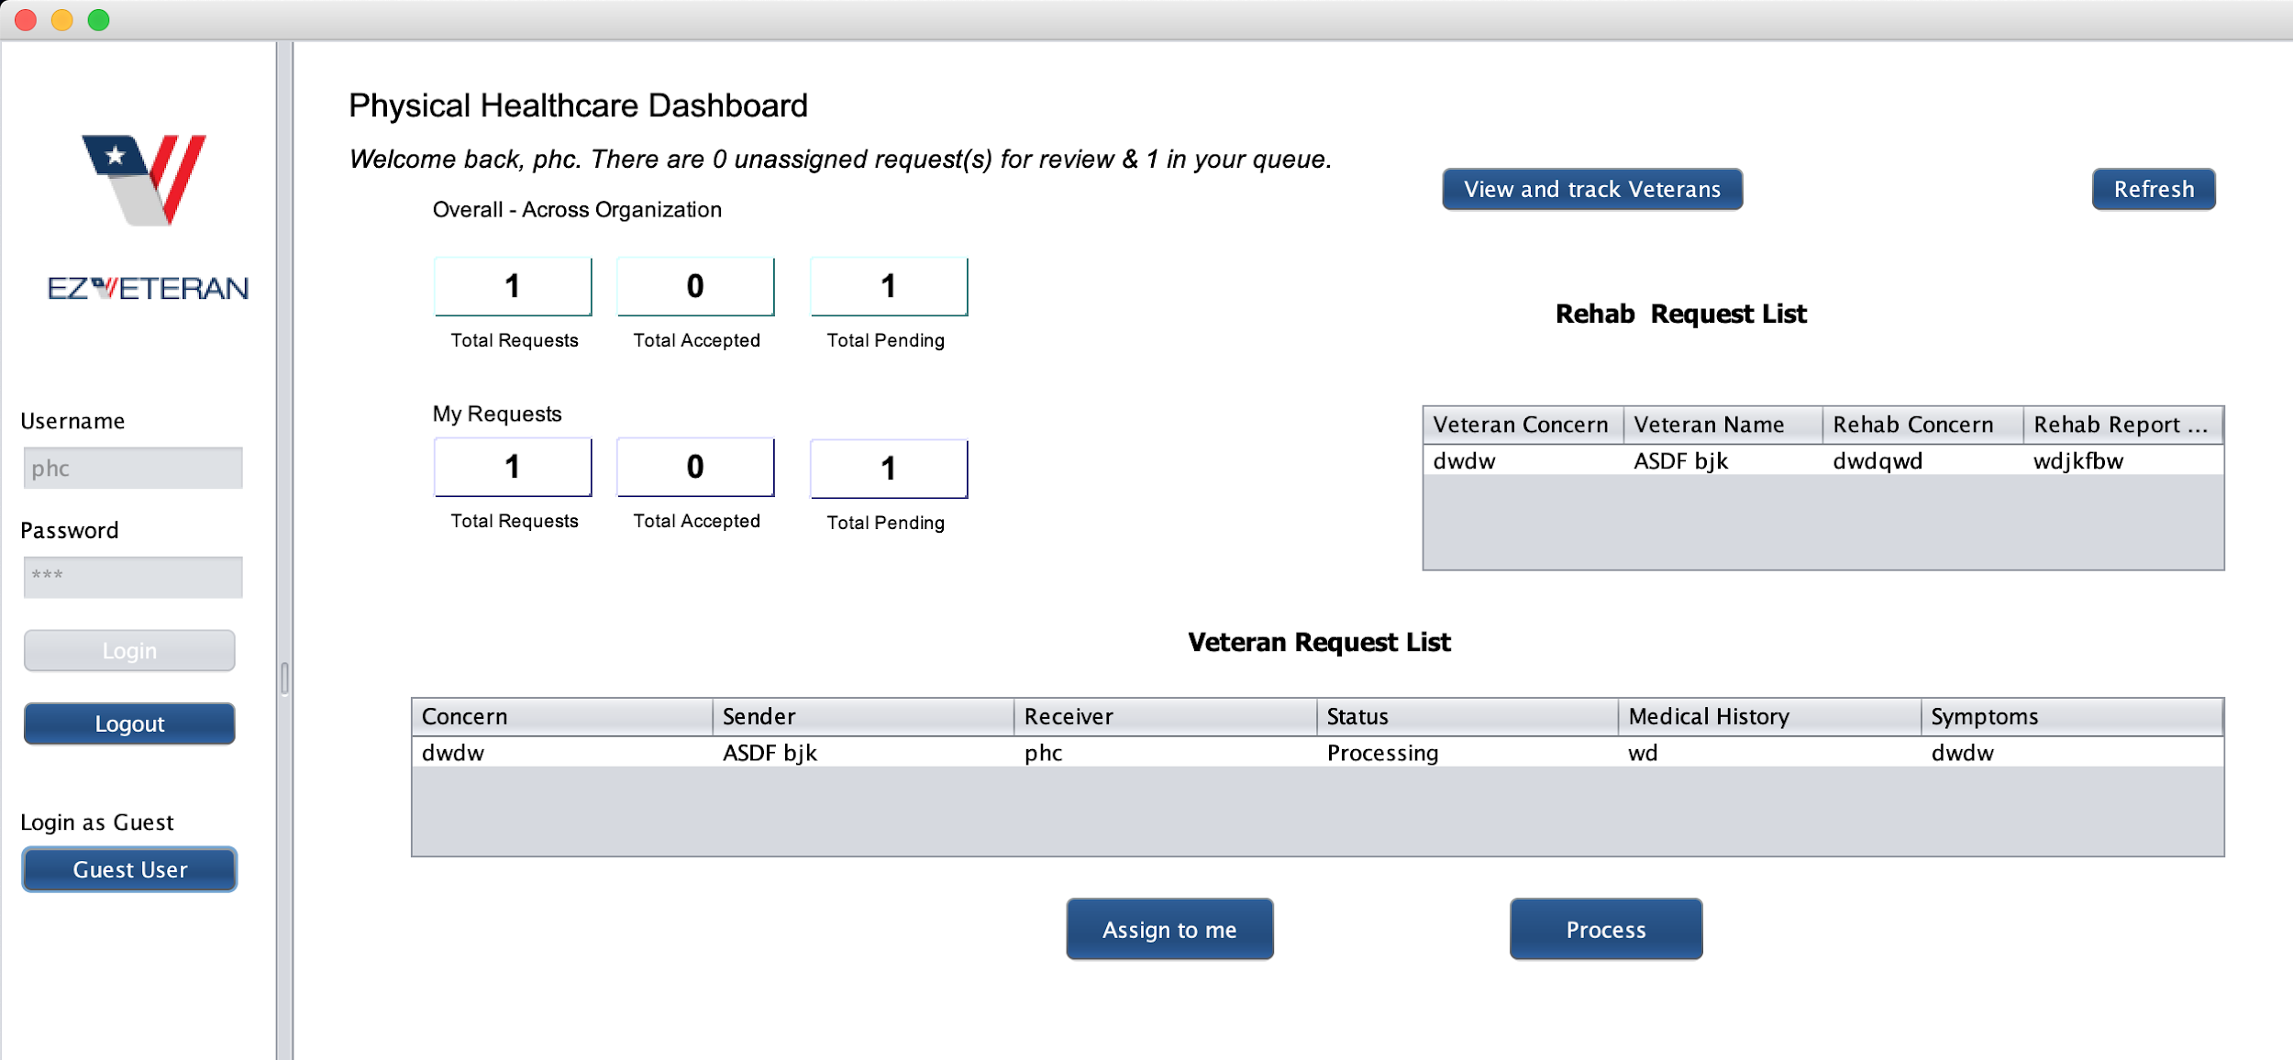
Screenshots

Slide 19
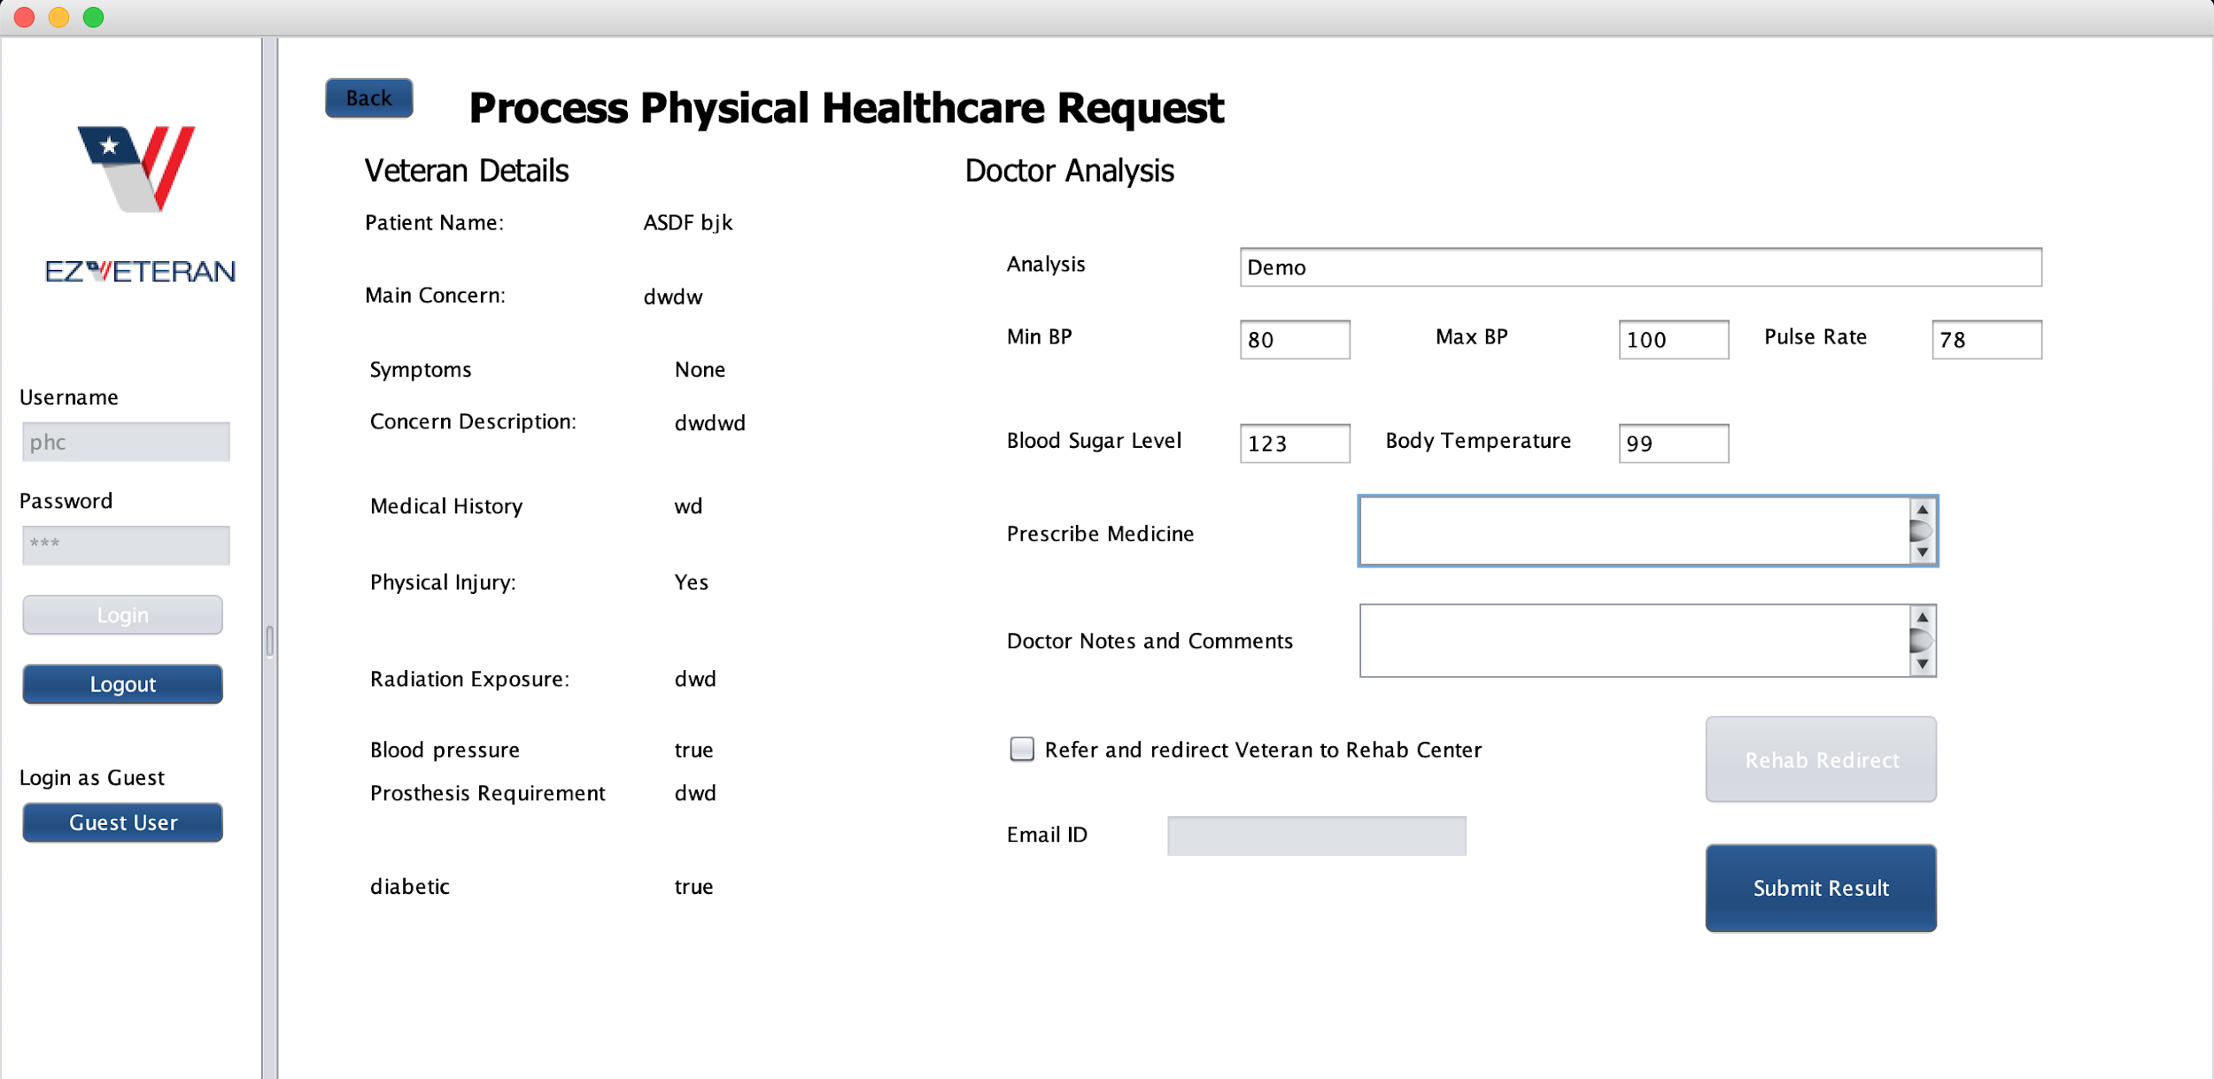
Screenshots

Slide 20
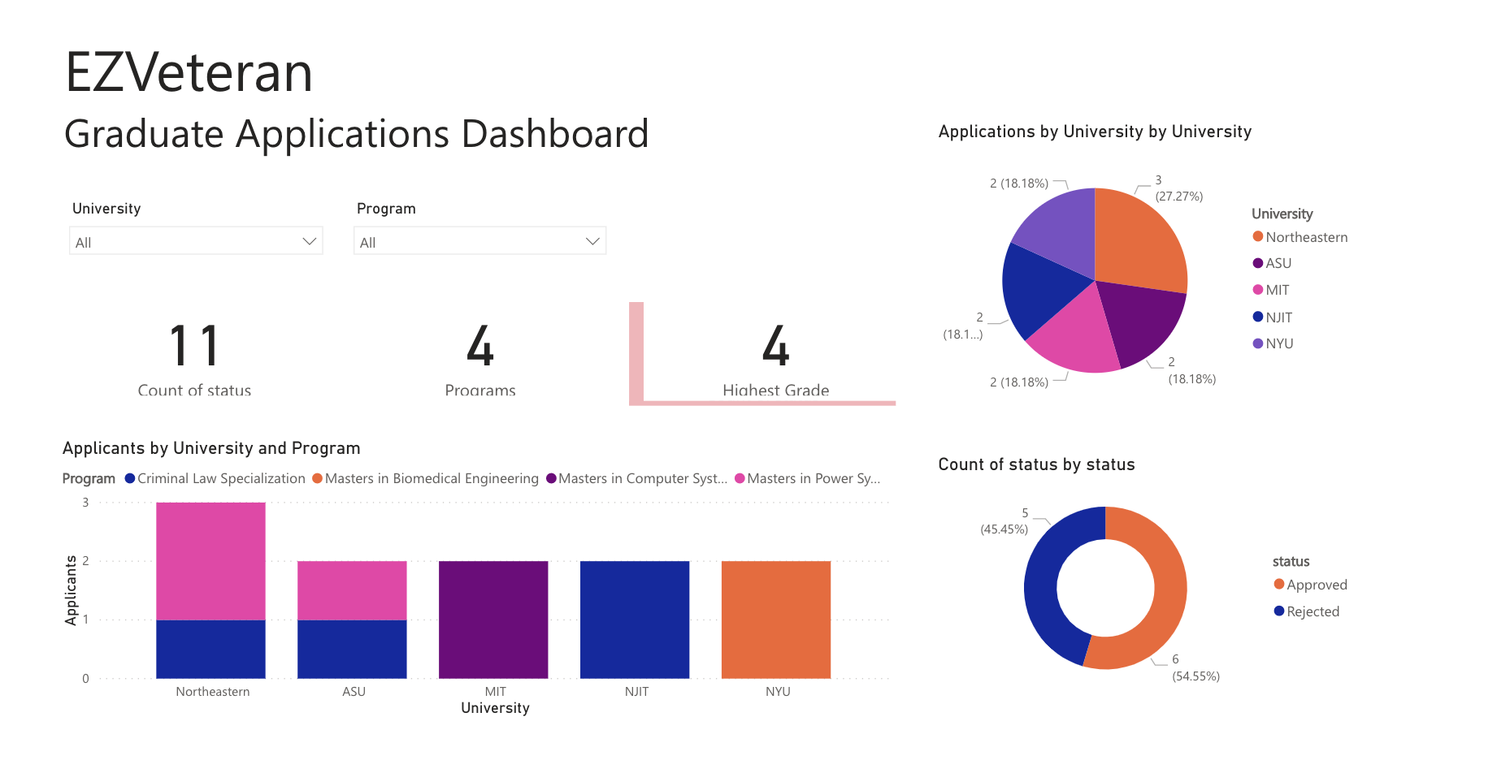
Reporting
https://app.powerbi.com/view?r=eyJrIjoiZmQxNzRkNDYtYmI2NC00MTMzLWIwZWItMTRmNzVmYzU3ZDRkIiwidCI6ImE4ZWVjMjgxLWFhYTMtNGRhZS1hYzliLTlhMzk4YjkyMTVlNyIsImMiOjN9

Slide 21
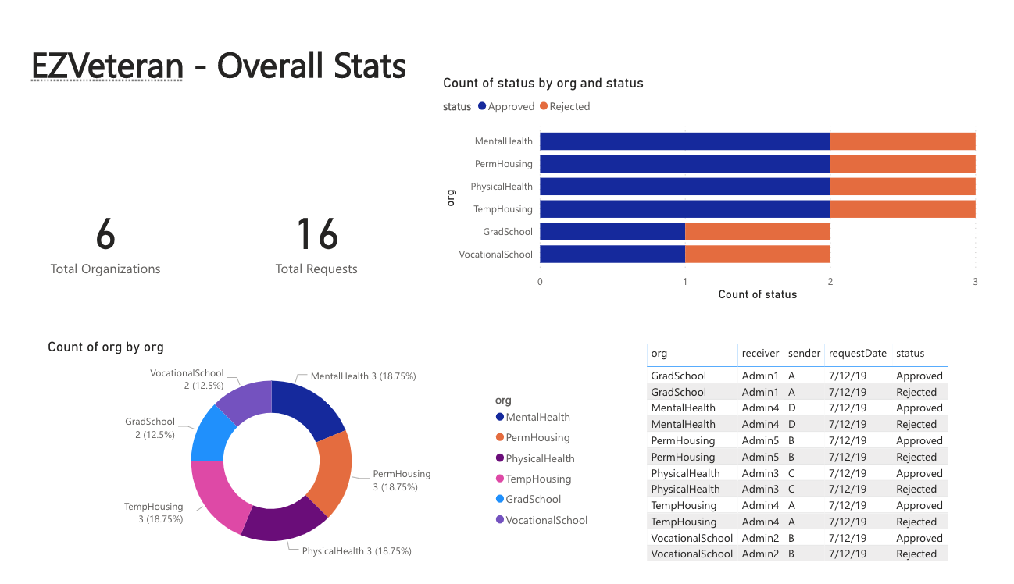
Reporting
https://app.powerbi.com/view?r=eyJrIjoiOGVkNDFiOGQtZmYyYi00ZTJjLTgyMzQtZjRkMzdiYTFkZjEyIiwidCI6ImE4ZWVjMjgxLWFhYTMtNGRhZS1hYzliLTlhMzk4YjkyMTVlNyIsImMiOjN9

Slide 22
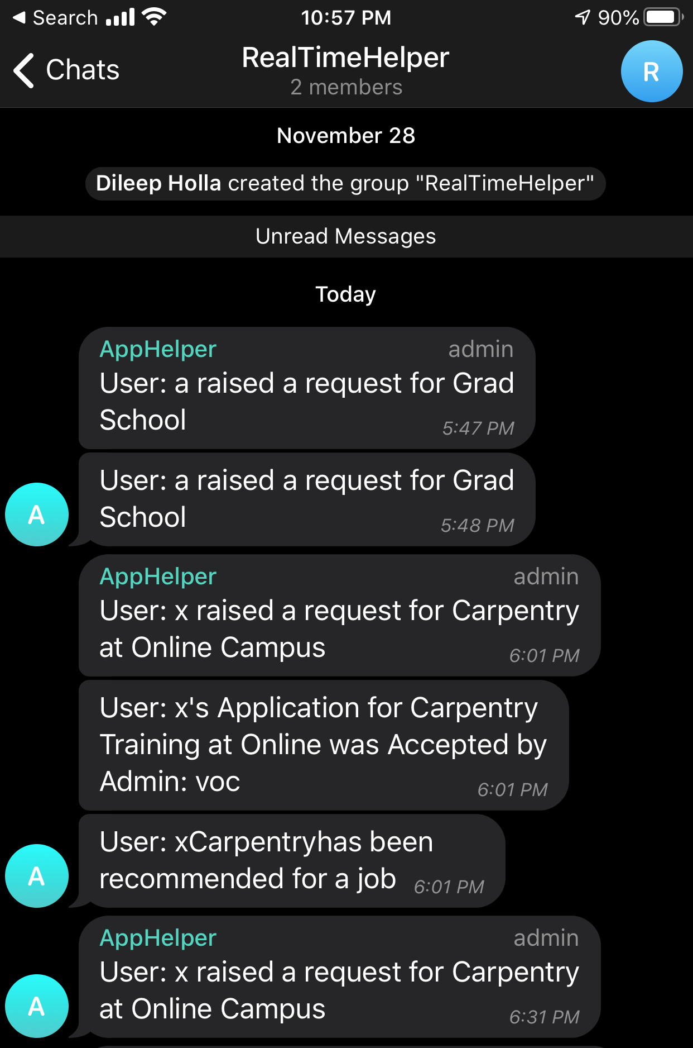

Real Time Notifications

Slide 23
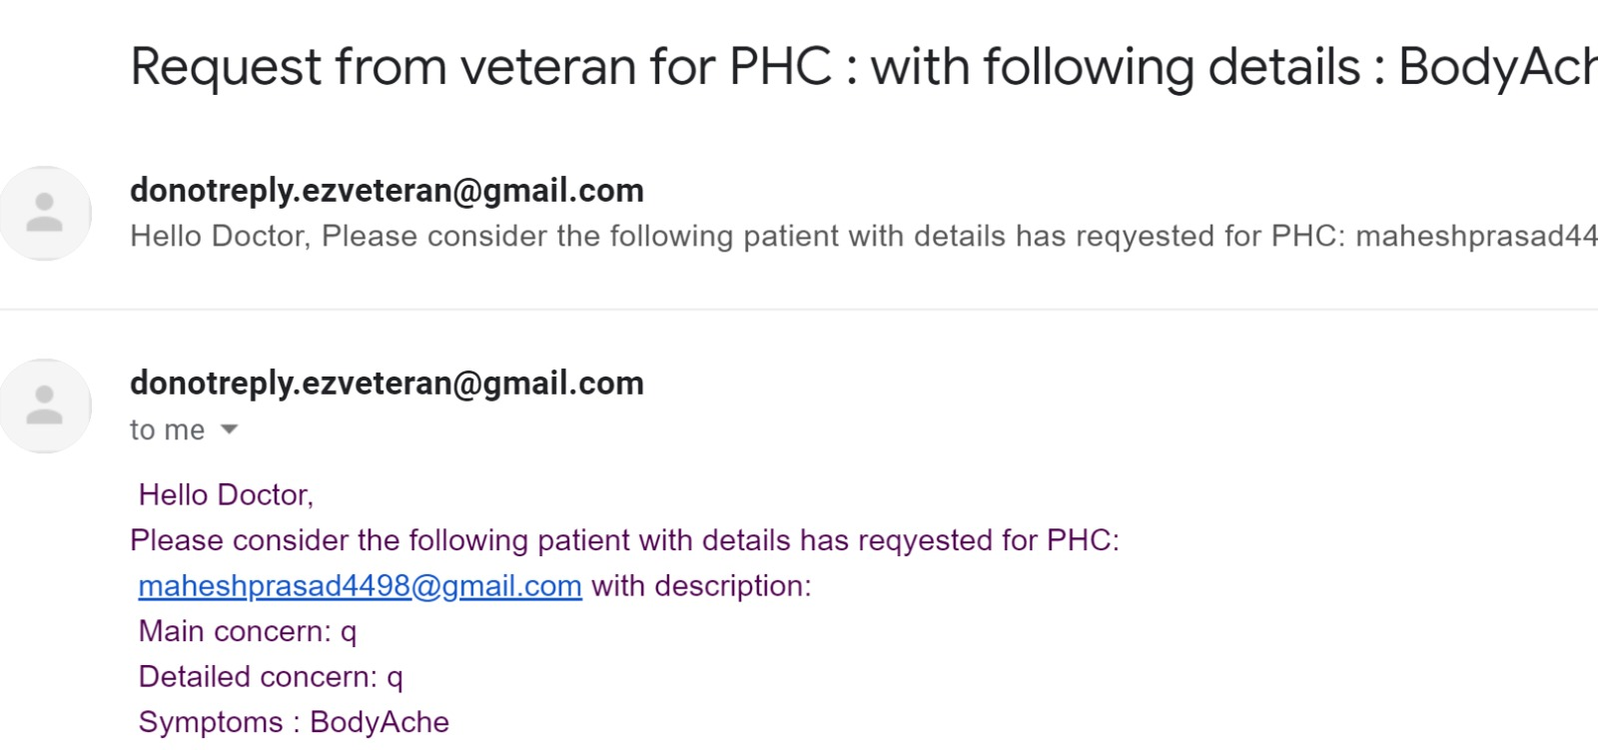
Email Notifications

Slide 24
Thank you!

